Slide 1
Photo Selection

Slide 2
Learn
It is our duty to take and select the best photos possible.
In the following slides, two photos about the same topic will be presented. Name the qualities that make the larger photo better.
Notes:
The following slides show photos of similar subjects, but one photo is more interesting than the other.

Slide 3
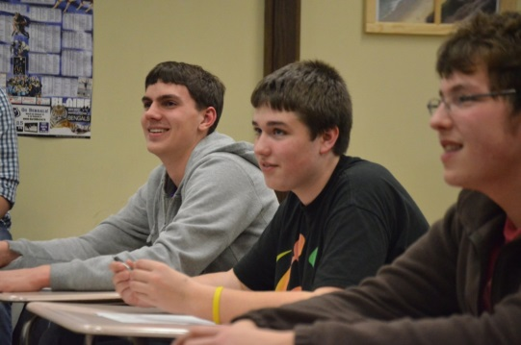
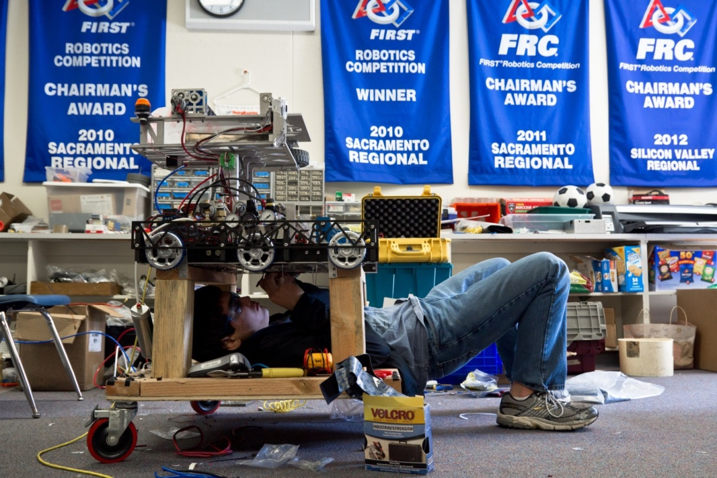
Engaging Photos
Brent Kyono, Leland High School [CA]
Notes:
Both of these photos are about classes within the school, but one is far more interesting than the other. Why?
Potential Answers: Angle at which the larger photo is taken, leading lines from the banners, the larger photo shows the EXPERIENCE of the class – someone doing something.

Slide 4
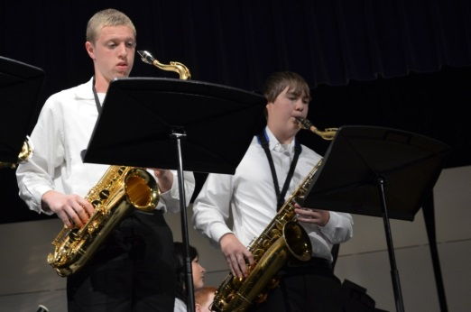
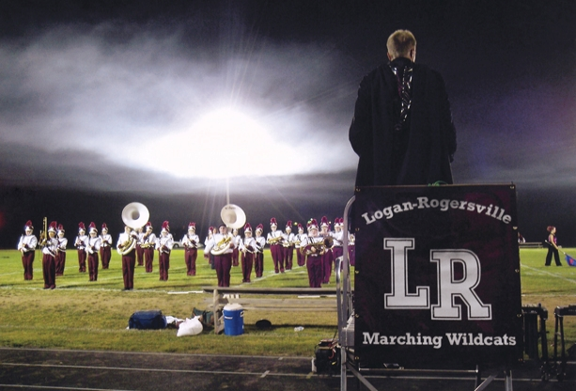
Engaging Photos
Logan-Rogersville High School
Notes:
Both of these photos are about band, but one is far more interesting than the other. Why?
Potential answers: lighting in the larger photo, composition of the larger photo, the larger photo tells a story.

Slide 5
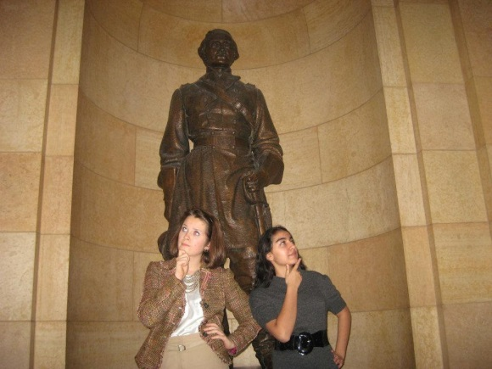
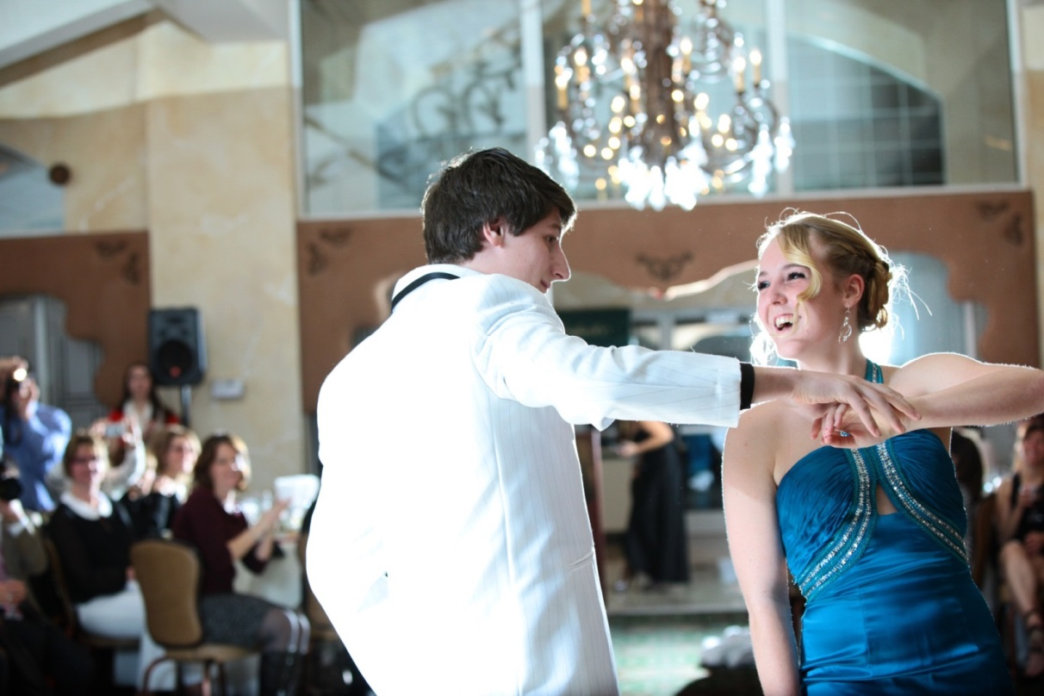
Engaging Photos
Trevor Munch, Ward Melville High School [NY]
Notes:
Both of these photos are about student life, but one is far more interesting than the other. Why?
Potential answers: the lighting in the larger photo, the interaction of the people, the composition, the larger photo tells a story.

Slide 6
Practice
You will see three photos on each of the following slides.
Discuss which photo would be the best as a dominant photo and why.

Slide 7
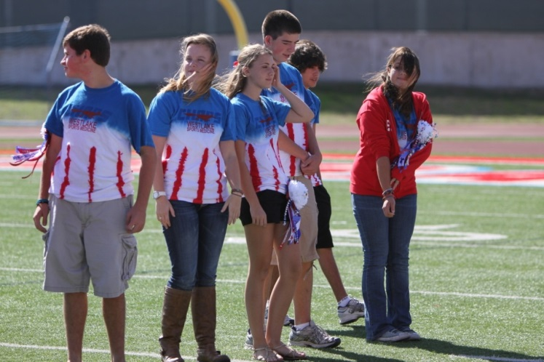
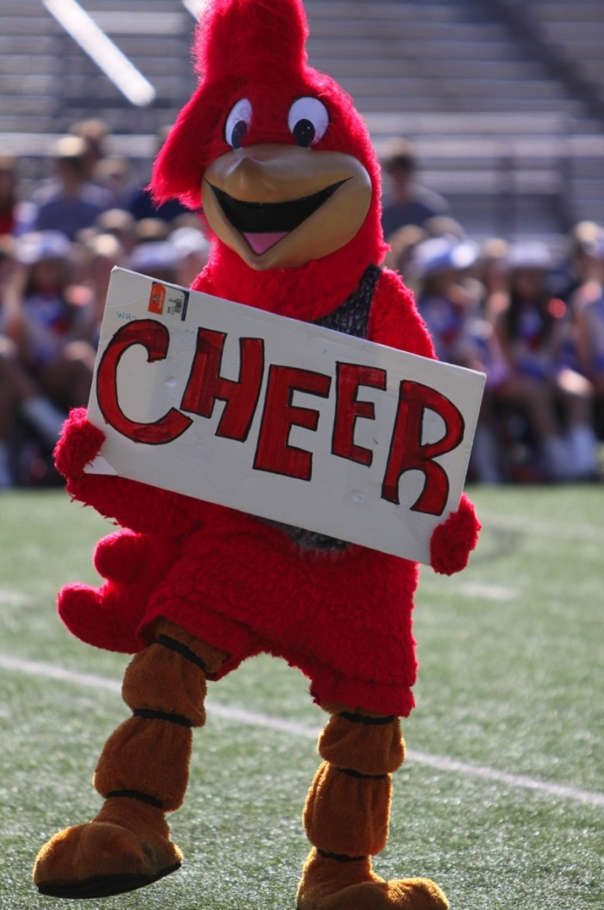
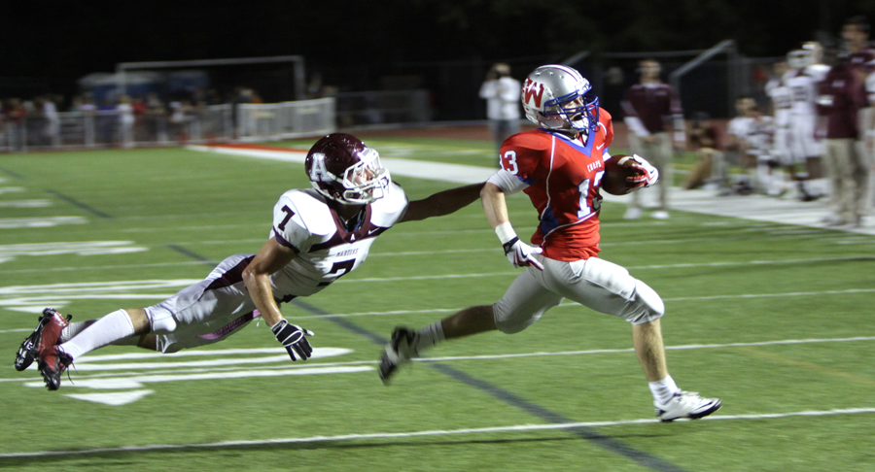
Which is Best?
2
1
3
Westlake High School [TX]
Notes:
Presenter: have students discuss which photo would be best as a dominant photo and why.

Slide 8
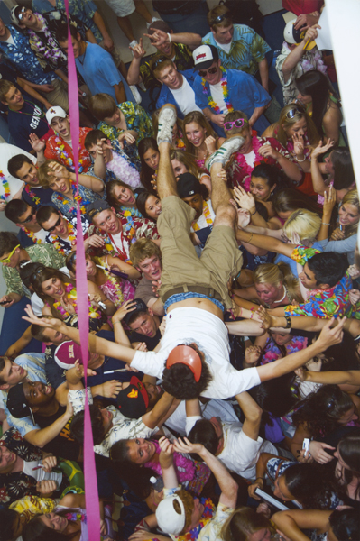
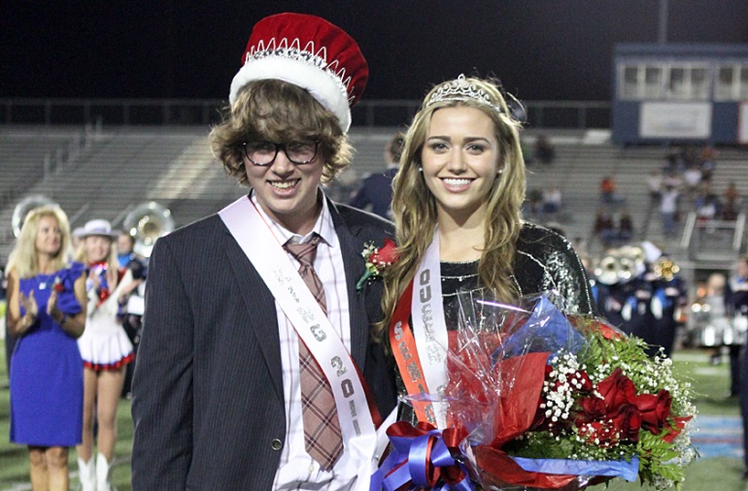
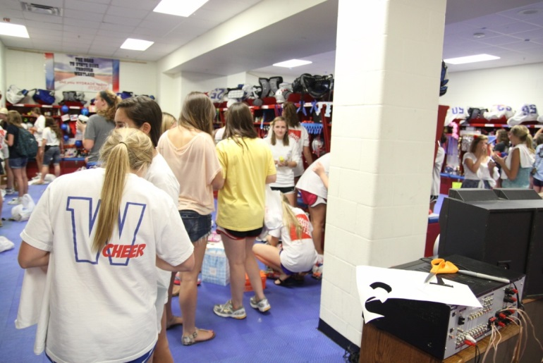
Which is Best?
2
1
3
Westlake High School [TX]
Notes:
Presenter: have students discuss which photo would be best as a dominant photo and why. What photo would be best as a smaller supporting photo or a photo in a module?

Slide 9
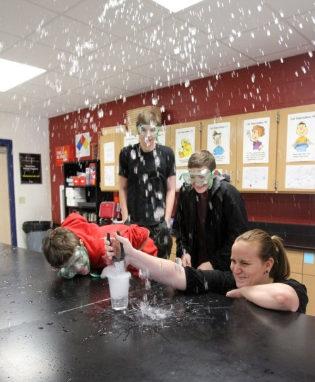
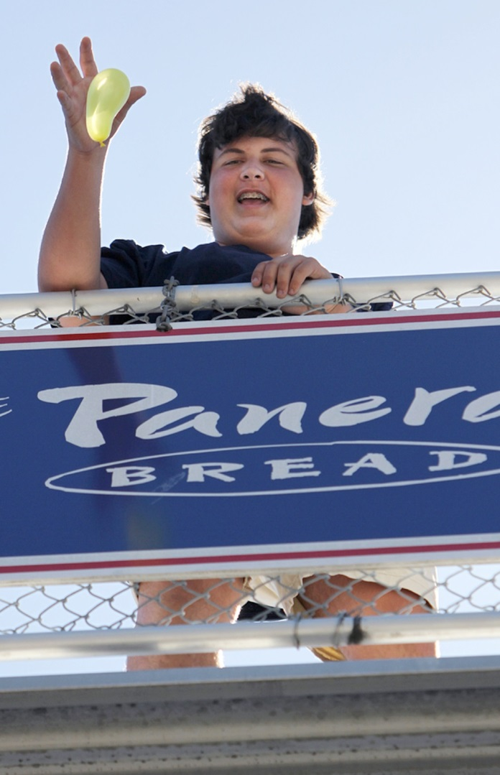
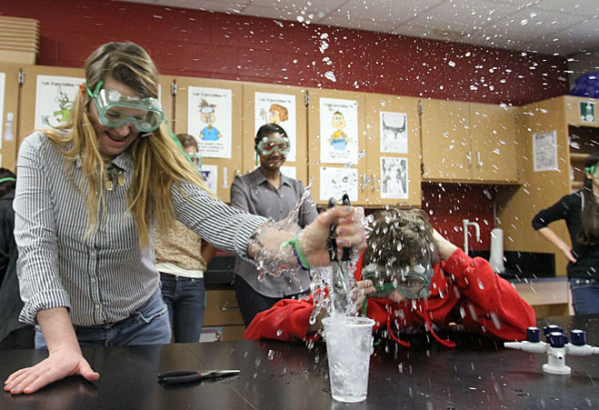
Which is Best?
1
3
2
Westlake High School [TX]
Notes:
Presenter: have students discuss which photo is best and why.
Note that photos can be selected for various reasons. Sometimes a photo is chosen not because it is the best but because it captures someone who has not been covered much.

Slide 10
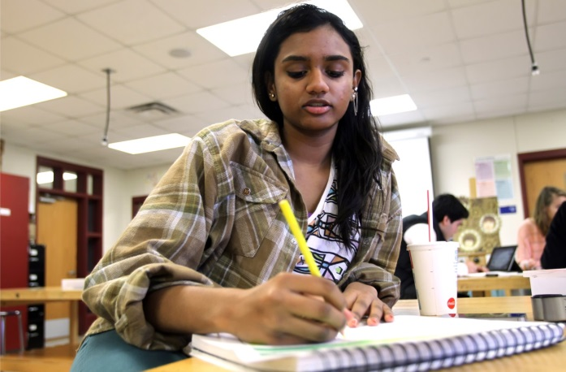
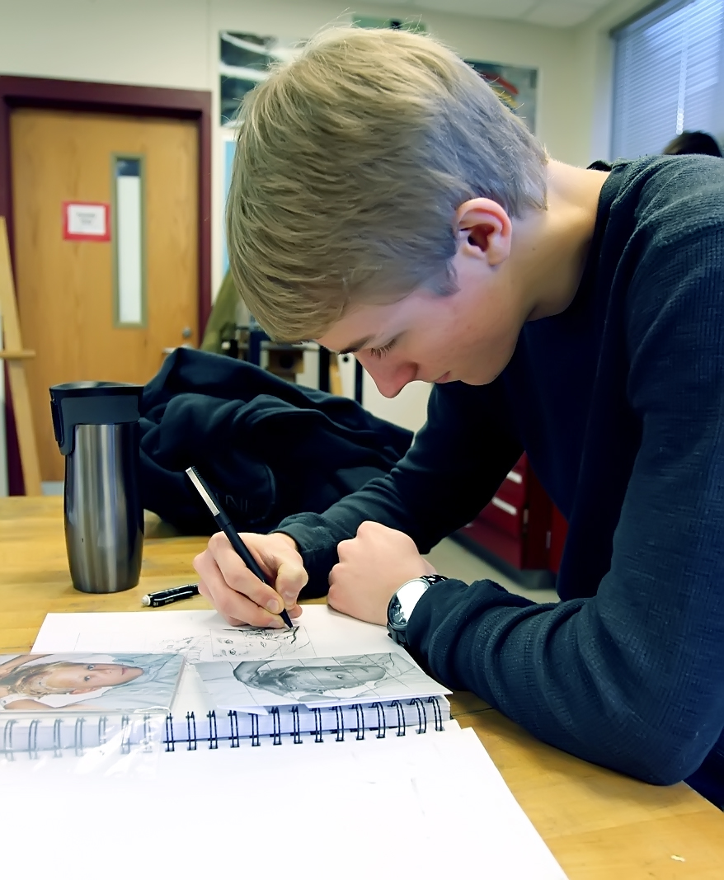
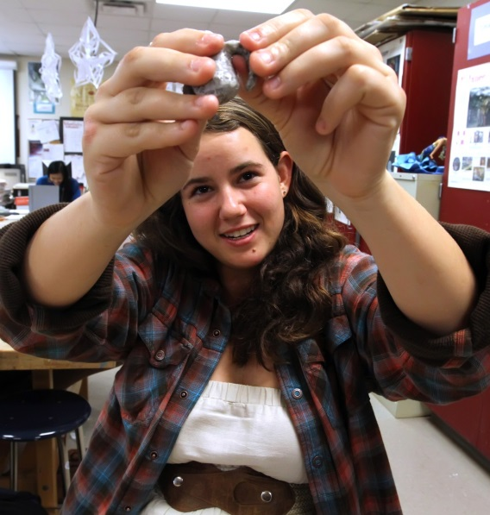
Which is Best?
1
3
2
Westlake High School [TX]
Notes:
Presenter: have students discuss which photo would be best as a dominant photo and why.
Note that the answer is not always clear. In this case the decision might be made based on the shape of the space available on the spread.

Slide 11
Use
Self-critique your yearbook spreads to make sure you have selected the best possible photos to tell the story of the school and the people in it.

